Slide 1
Public management and outcomes for children
Toby Lowe, Visiting Prof of Public Management, CPI
@tobyjlowe

Slide 2


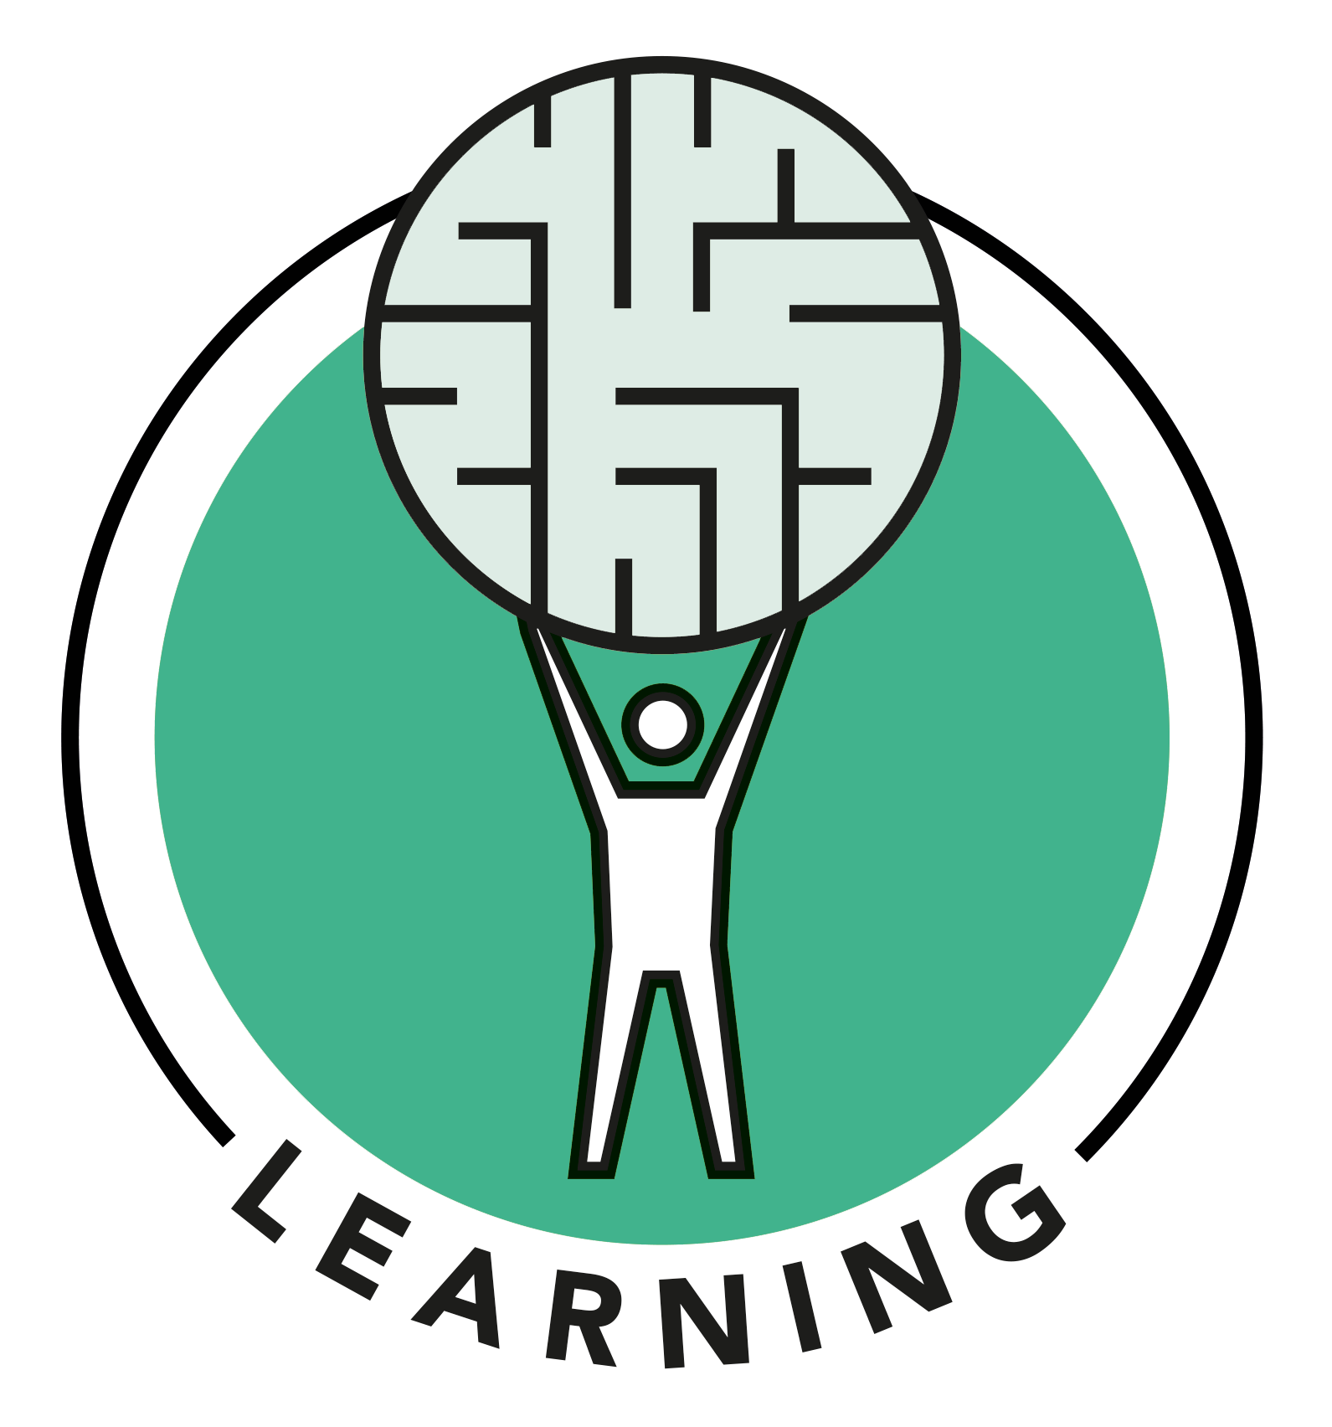
  How is an outcome made?
  The evidence on performance managing for outcomes
  Creating outcomes requires doing public management differently
  Case studies of commissioning differently
Overview
Question:
How can commissioning help people create outcomes in their lives?

Slide 3
A shared starting point
  The purpose of public service is to help people to create good outcomes in their lives
  How can commissioning support people to create good outcomes in their lives?

Slide 4
  How is an outcome created?

Slide 5
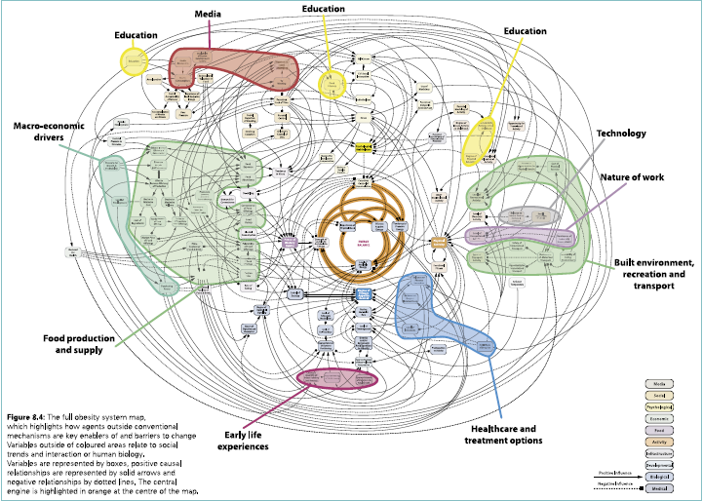

Slide 6
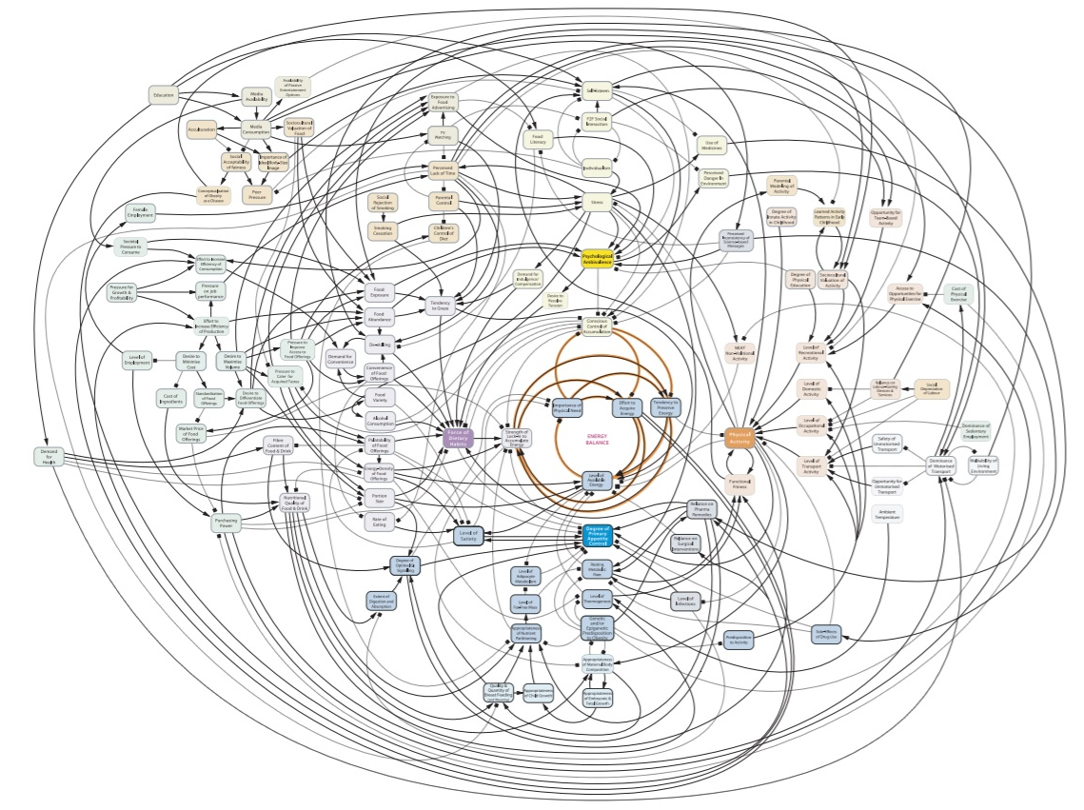
Max
Rob
Toby
Mary-Lee
Notes:
Variety
Interventions don’t have uniformity

Slide 7
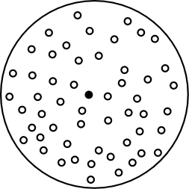
Max
Rob
Toby
Mary-Lee
Notes:
Unpredictability and instability
Interventions don’t have longevity

Slide 9
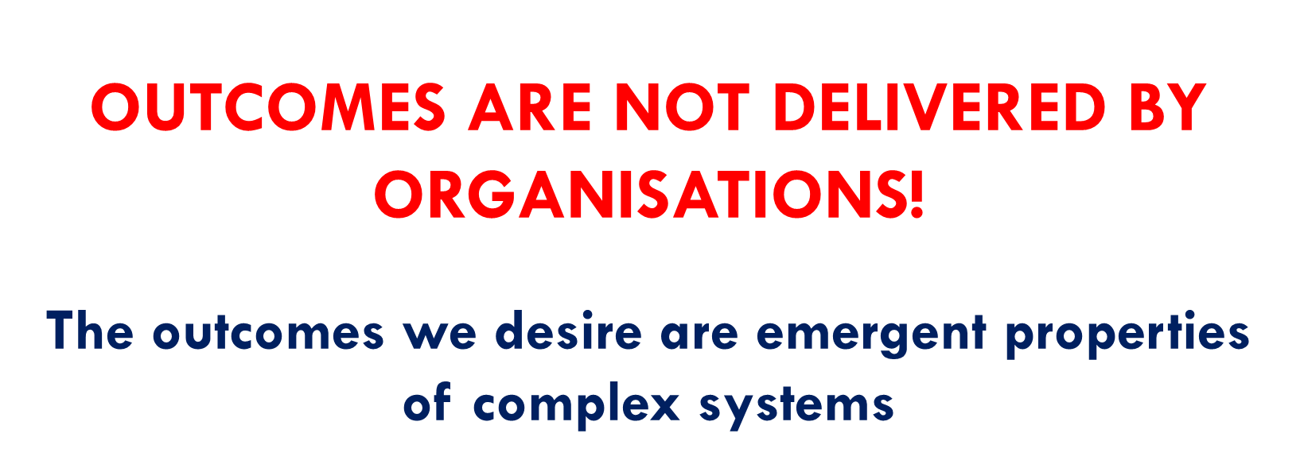

Slide 10
Implications for public management
  You cannot contract an organisation/programme to “deliver” an outcome
  Contracting and performance managing for outcomes holds people accountable for things they cannot control
  What happens if you try? Here’s the evidence….

Slide 11
“The overall conclusion from international experience of implementing an outcomes approach is that the journey is long and the results are disappointing.”
Wimbush, Erica (2011): “Implementing an outcomes approach to public management and accountability in the UK—are we learning the lessons?”, Public Money & Management, 31 (3) pp. 211-218

Slide 12
Gaming
Outcome-based contracting turns everyone’s job into the production of good-looking data, not meeting client need.

Slide 13
If commissioners shouldn’t seek to purchase outcomes, what should they do?
Embrace the complex reality of how outcomes are made

Slide 14
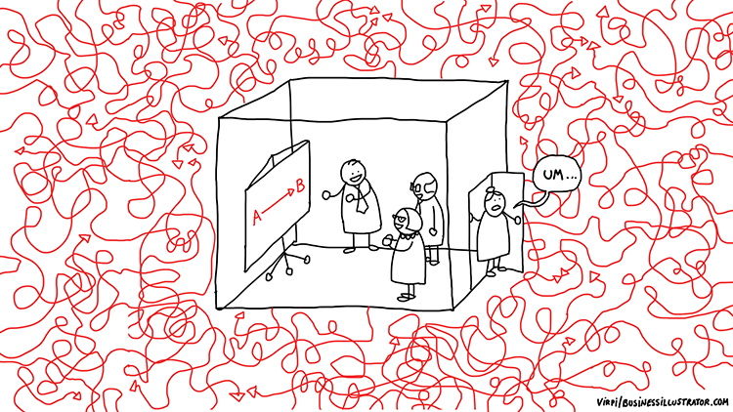

Slide 15

www.humanlearning.systems

Slide 16
Learning from doing
  48 case studies of HLS in practice
  29 created especially for this report
  From local voluntary sector organisations to national governments
  We know what an alternative approach to public management looks like, because we have seen these people do it.
  Our knowledge is incomplete
  So much still to learn.

Slide 17
  Zooming in:
  How is a desirable outcome created
  in each person’s life?

Slide 18
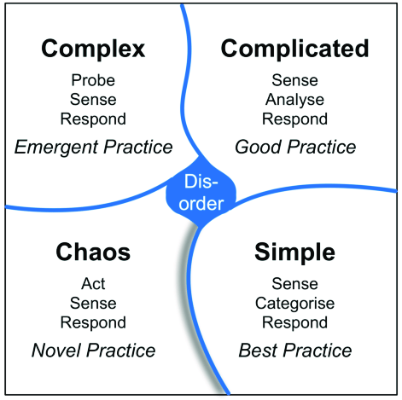
How do we manage to help create positive outcomes?
Creating an outcome is complex:
Each person’s life is different
What counts as an outcome is different
The way an outcome is made is different
It changes over time

Slide 19
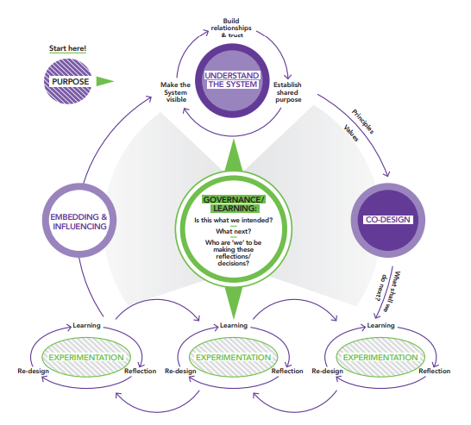
How could we help someone who experiences chronic pain?
Running a Learning Cycle with each person = Bespoke social action
Notes:
The change process seems to be an example of HLS practice

Slide 20
  What should commissioners do?
  Commission organisations in a way which enables these public facing Learning Cycles:
  = commission for learning, not for a prescribed service

Slide 21
  What should commissioners do?
  Enable Learning Cycles at all system scales

Slide 22
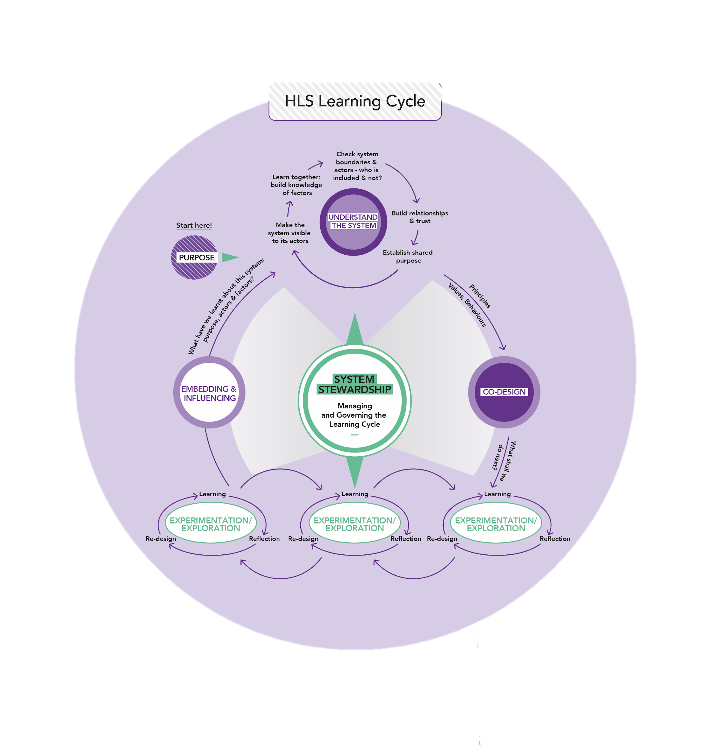
Systems operate at different scales

Slide 23
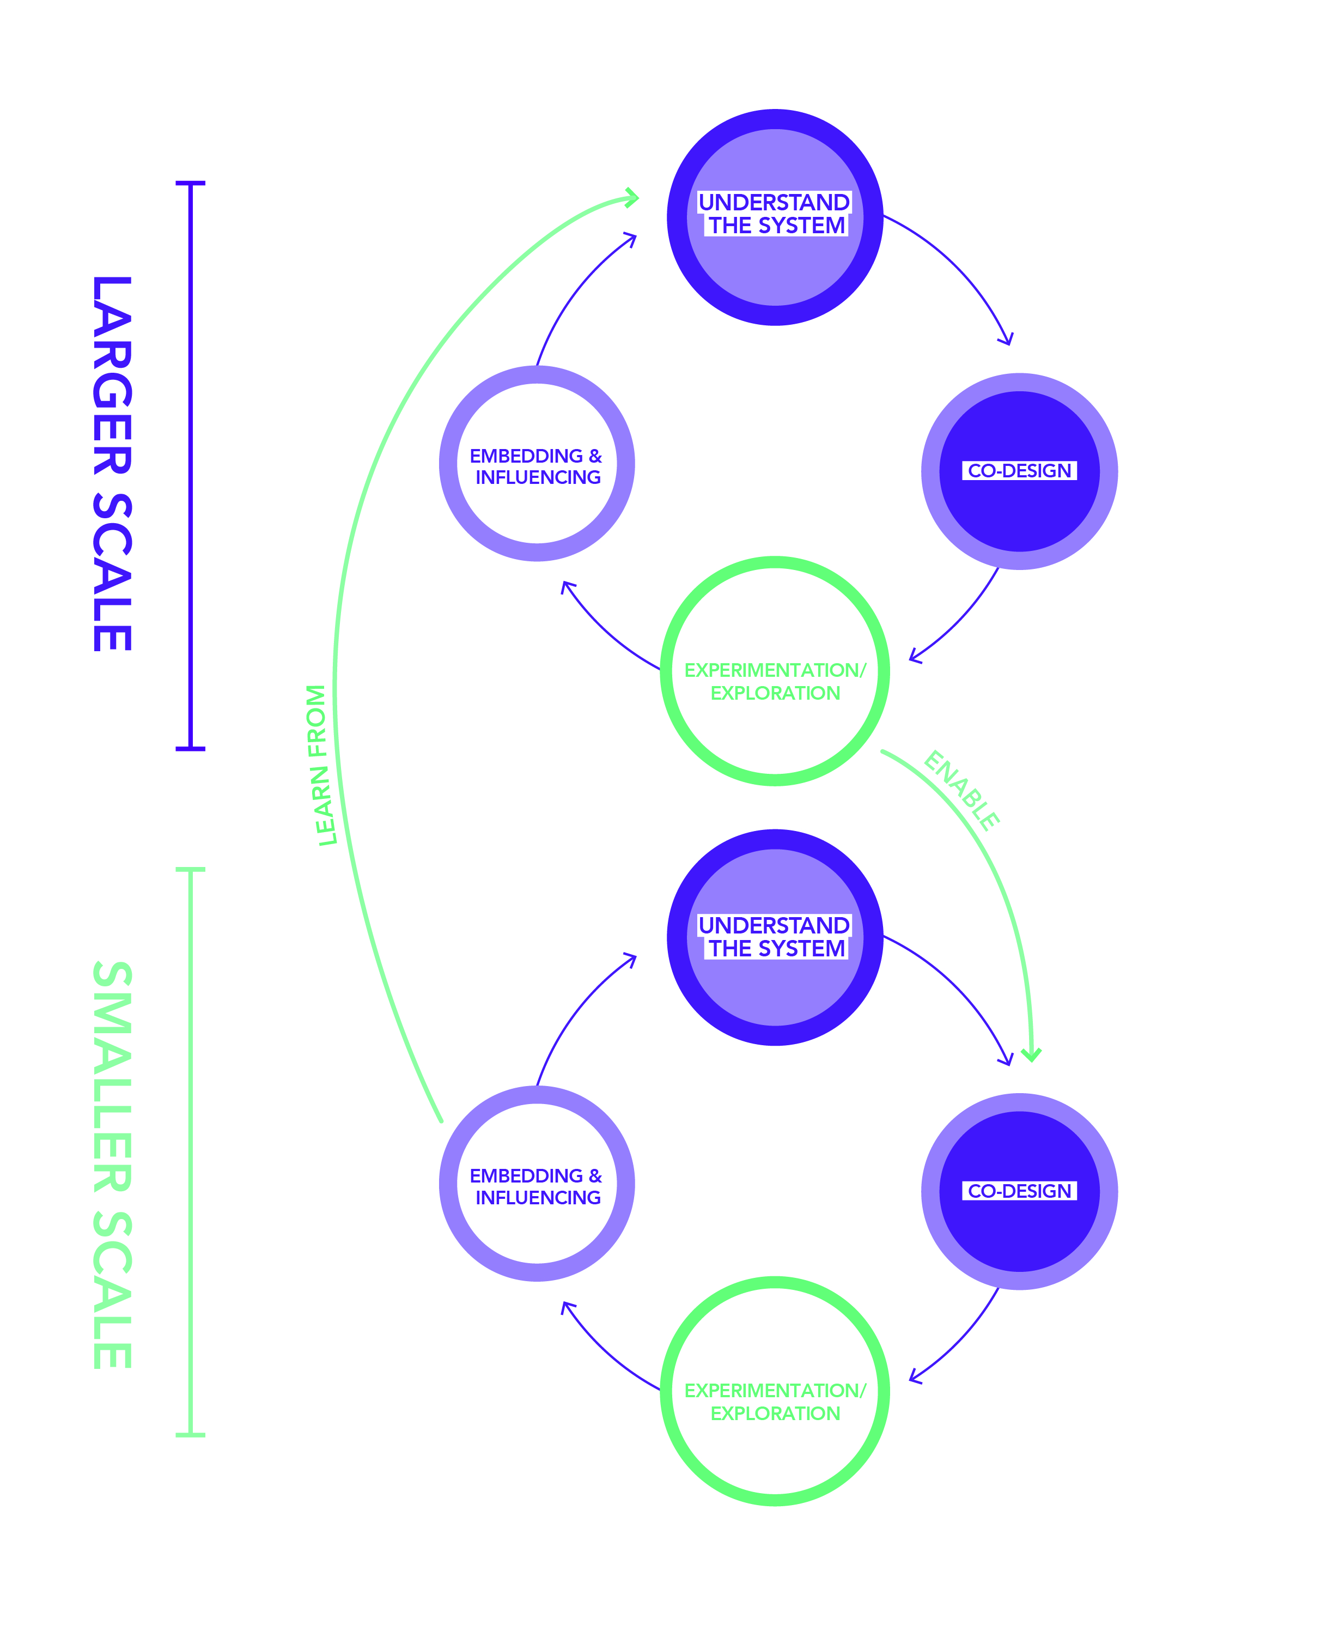
  Questions for “organisation” system scale:
  “Learning from” questions:
  What patterns do we see from across all the “person’s life as systems”?
  What policies do we need to change to enable change for people?
  e.g. do we need to change our housing allocation policies?
  “Enabling” questions:
  What are maximum case loads for workers?
  What information systems do we need?
  What shared reflective practice spaces?
  What staff capabilities?

Slide 24
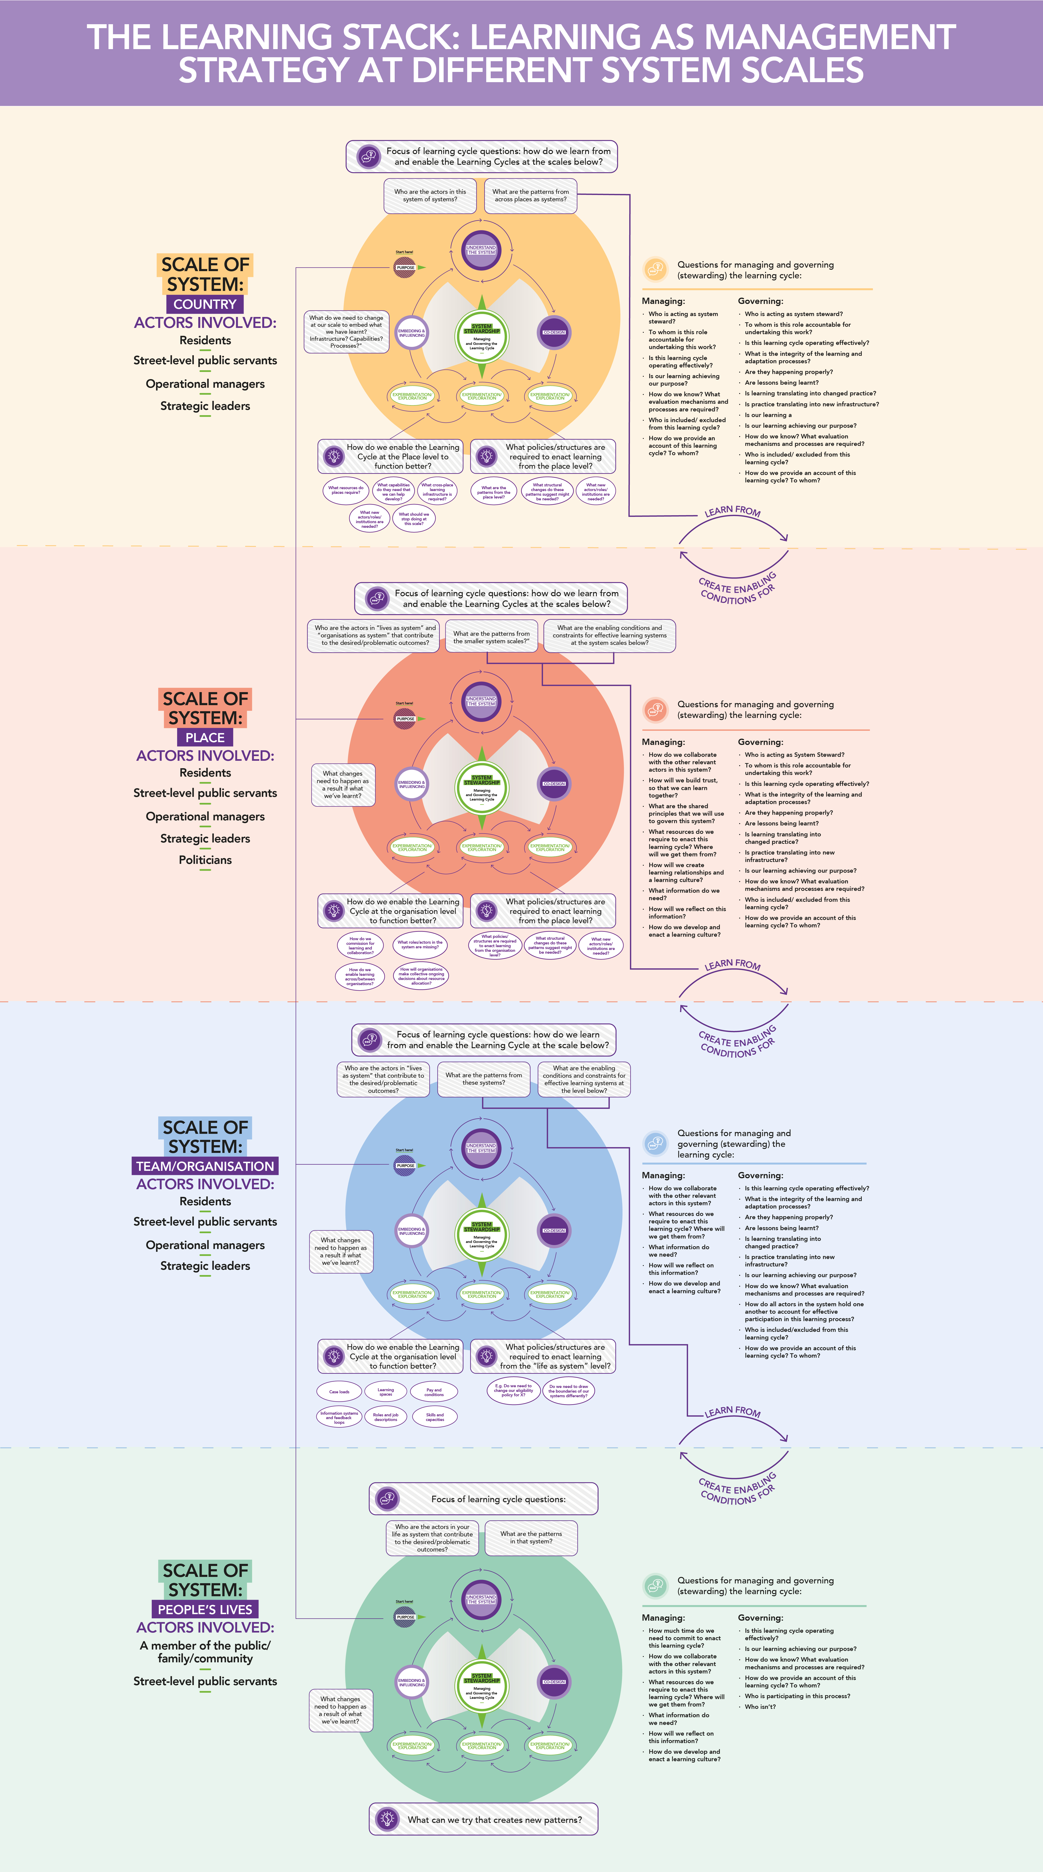
A connected “stack” of Learning Cycles

Slide 25
  = Paradigm shift in public management
  Not just a change in commissioning practice, but a change in the purpose of commissioning:
  From purchases of services to
  System Stewards.

Slide 26
Summary
  Taking outcomes seriously requires doing public management differently:
  Start with the reality of how outcomes are made.
  Adopt learning as the management strategy. As a leader, your primary task is to create learning environments.
  Apply this strategy to all system scales – person, organisation, place, country/region.
Payoff: Better outcomes for less money. Happier people.

Slide 27

Example: Plymouth Alliance
Key messages:
£80m 10 year commission for adults with complex needs
Alliance contract
No targets, no KPIs
Orgs commissioned to learn together to achieve shared purpose
Learning together builds trust
Significant cash savings – e.g. emergency accommodation spending halved in 6 months
Better outcomes for citizens – e.g. fewer homeless people, greater recovery levels

Slide 28
Example: Liverpool Combined Authority
Commission of
If you want learning, you need to commission for learning
Learning together builds trust
Other examples:
The role of national government is to create learning environments
Healthcare Improvement Scotland
Foreign & Commonwealth Development Office

Slide 29
www.humanlearning.systems

