Slide 1
Getting back to work: Recovering from Covid-19
Tony Wilson, Institute Director, IES
tony.wilson@employment-studies.co.uk
@tonywilsonIES

Slide 2
This has been a crisis like no other

Slide 3
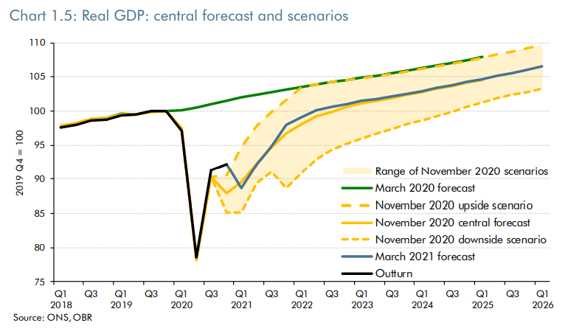
While things are recovering, it won’t be a “V”: this recession will leave a permanent ‘scar’
Outturn
November forecast

Slide 4
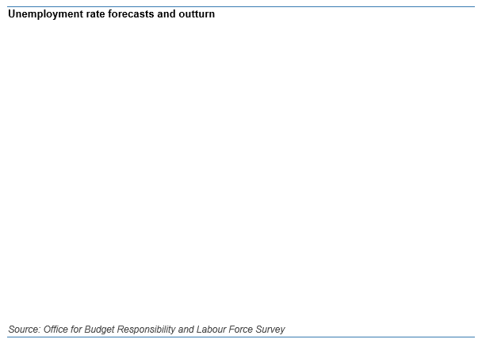
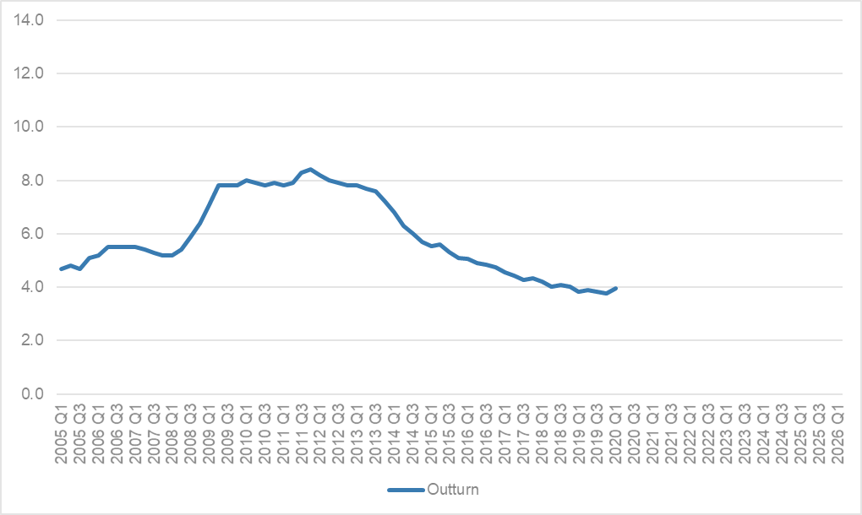
However, things could have been far worse: We’ve averted an unemployment catastrophe

Slide 5
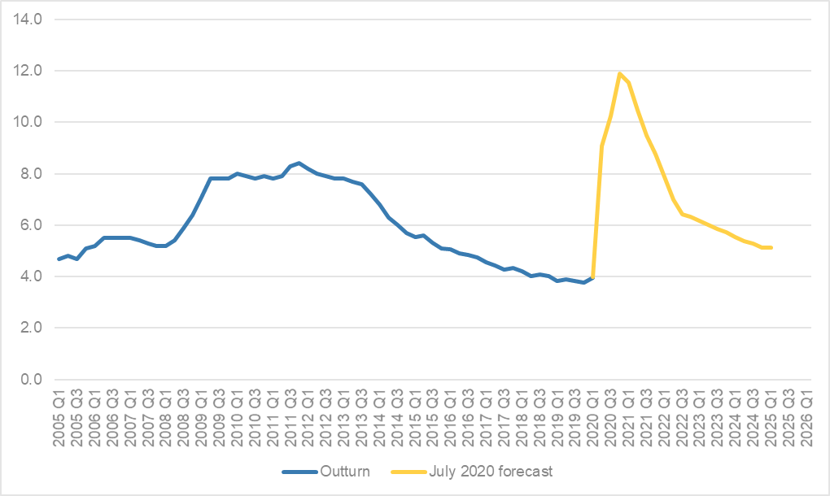
However, things could have been far worse: We’ve averted an unemployment catastrophe

Slide 6
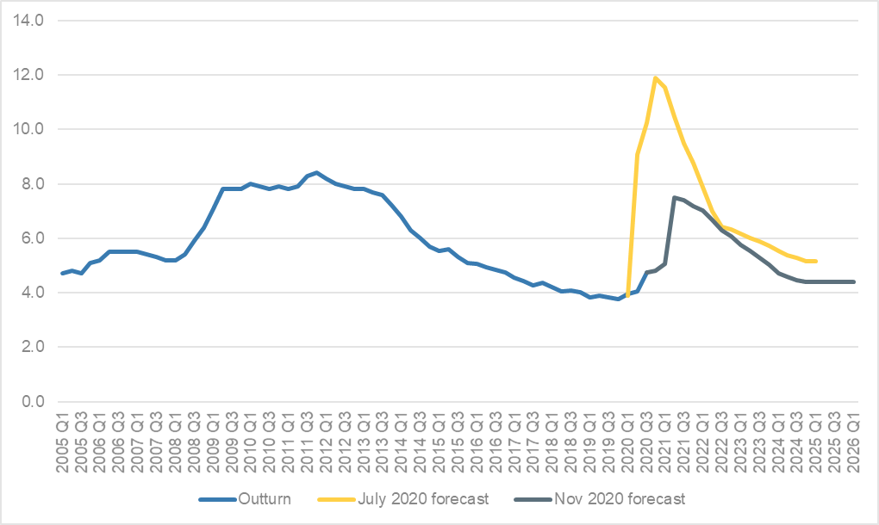
However, things could have been far worse: We’ve averted an unemployment catastrophe

Slide 7
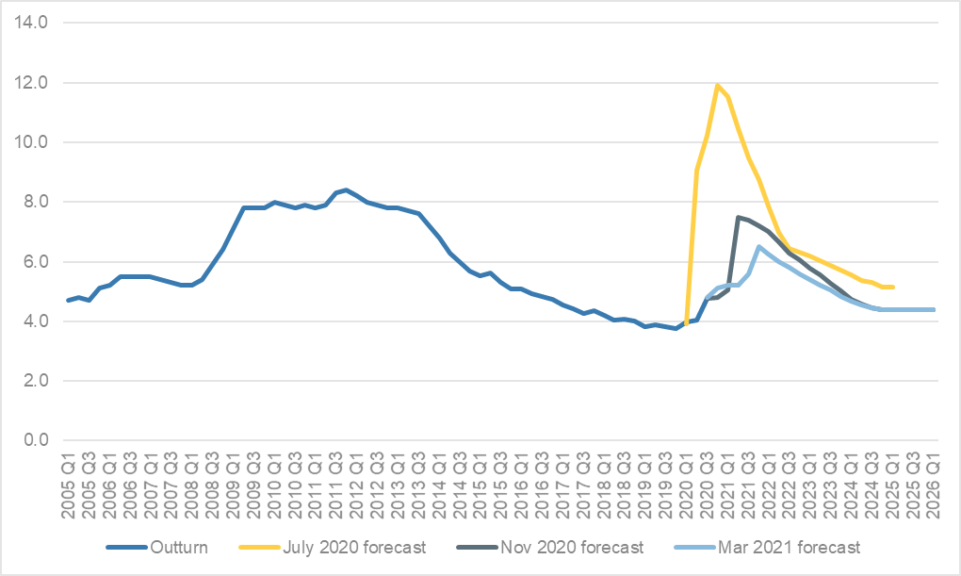
However, things could have been far worse: We’ve averted an unemployment catastrophe

Slide 8
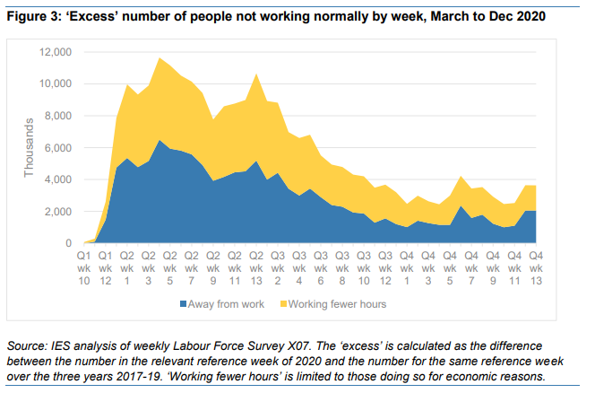
Aided by furlough and short-hours working – with at peak over 10m workers – one third of all – off work or on reduced hours

Slide 9
How bad could it have been?
GDP fell by 9.9% in 2020 – largest fall on record
Payrolled employment fell by 800k – likely largest since early 1990s…
… But ‘just’ a 2.7% fall
If employment had followed GDP, it would have fallen by 2.9 million
This crisis will almost certainly lead to the lowest post-recession peak in unemployment since 1975 (when output fell by 2%)

Slide 10
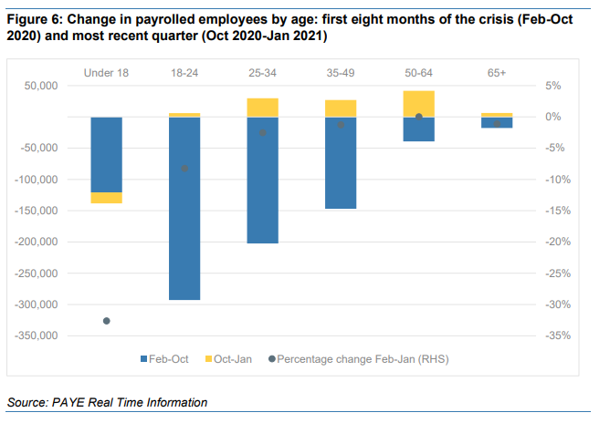
But “could have been worse” is as good as it gets – young people have been hit hard…

Slide 11
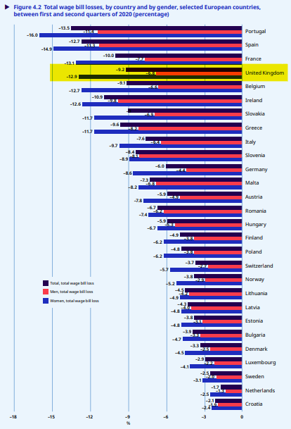
… While our analysis for the ILO found that women in the UK have seen the biggest wage bill loss of any country in Europe…

Slide 12
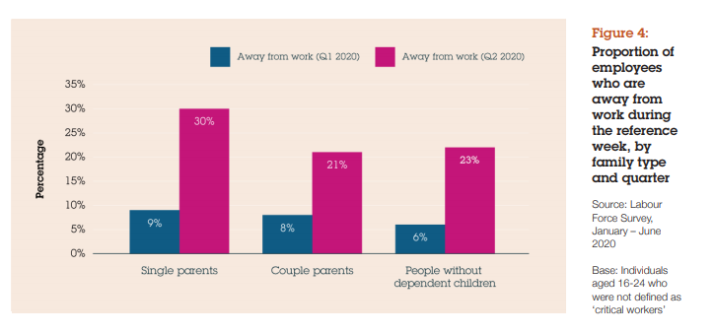
And our work with Gingerbread illustrates how single parents in particular lost out

Slide 13
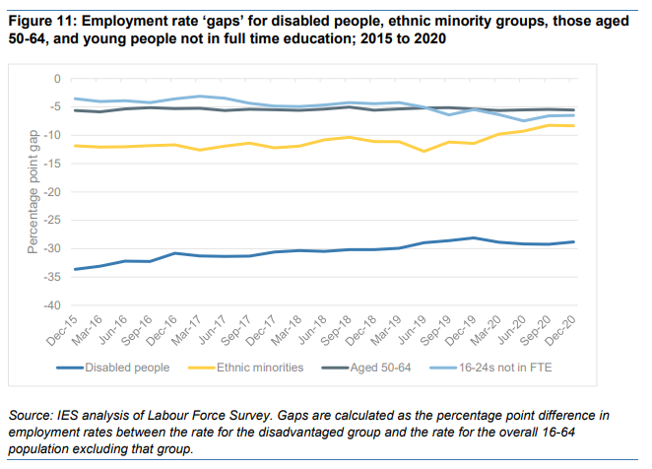
The disability employment gap has stopped narrowing…

Slide 14
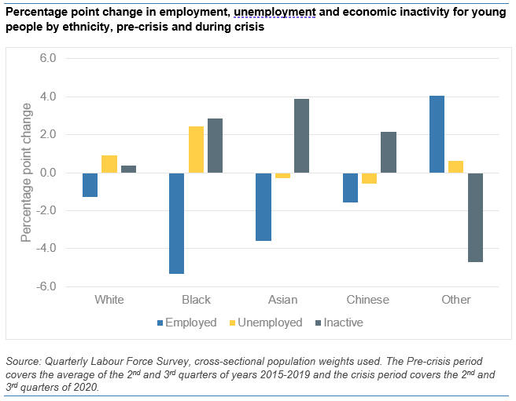
With recent work showing the Black and Asian young people particularly hard hit

Slide 15
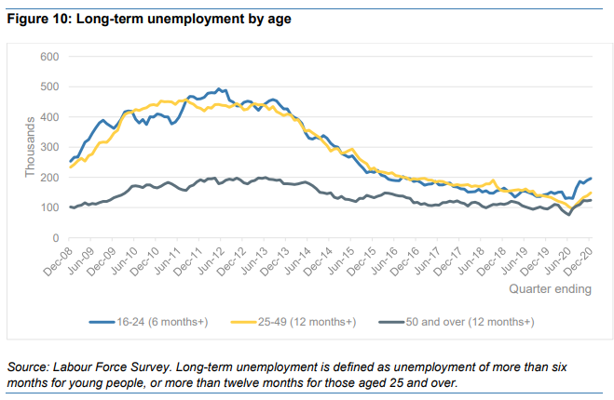
Clear signs that long-term unemployment is on the rise – particularly for young people

Slide 16
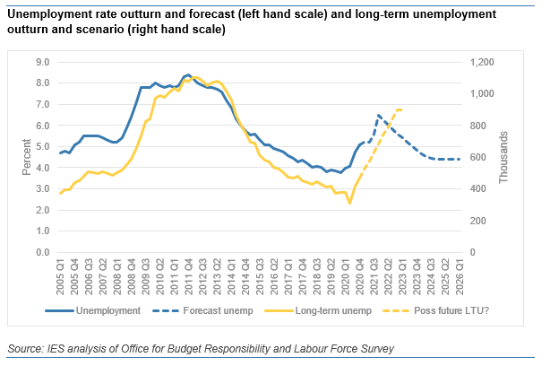
And it’s likely to more than double to around 900k in 2022

Slide 17
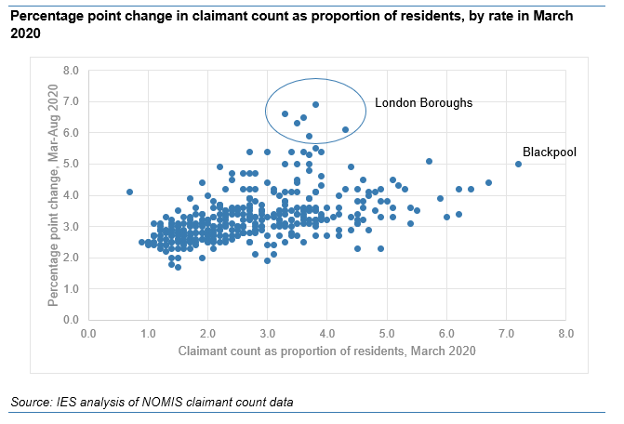
Place: Rises in the claimant count have been pretty similar across areas…

Slide 18
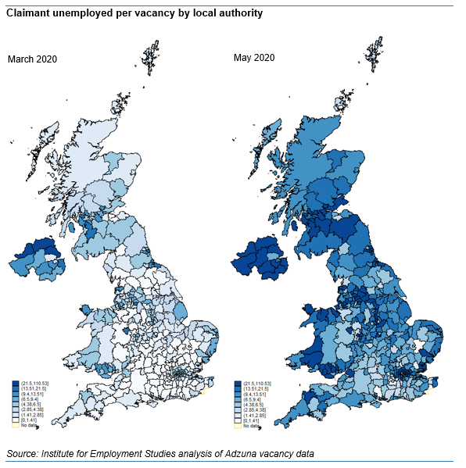
But – looking at claimants per vacancy, inner city, ex-industrial and coastal areas fared worse

Slide 19
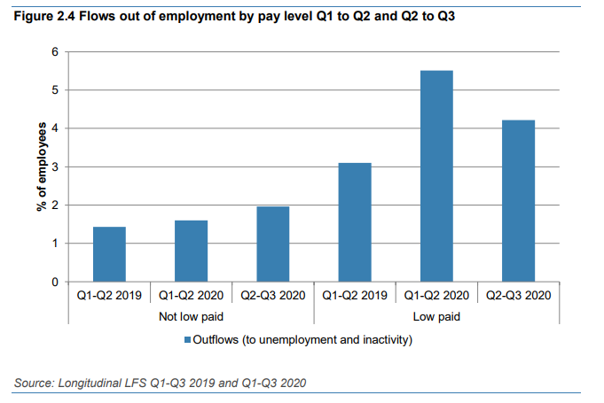
And this has been a crisis for the low paid – more than 3x more likely to have lost jobs

Slide 20
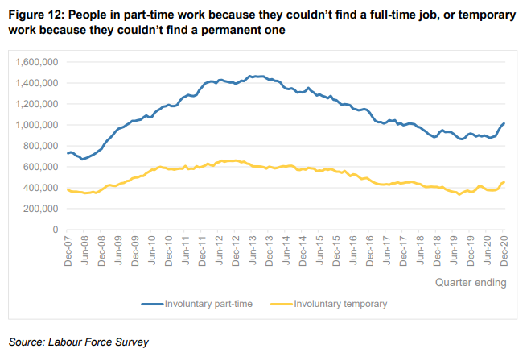
With signs that involuntary temporary and part-time work is on the rise again…

Slide 21
That’s the bad news!

Slide 22
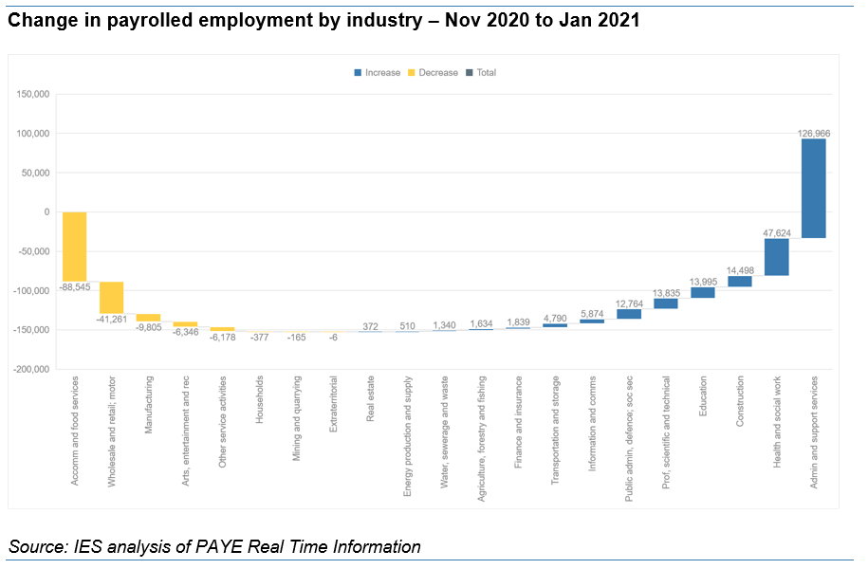
Payrolled employment is now growing, driven by pandemic jobs – but other industries too

Slide 23
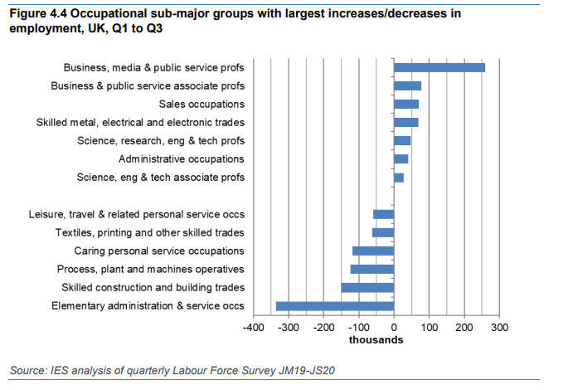
With early signs that this is speeding up a shift from lower to higher skilled work

Slide 24
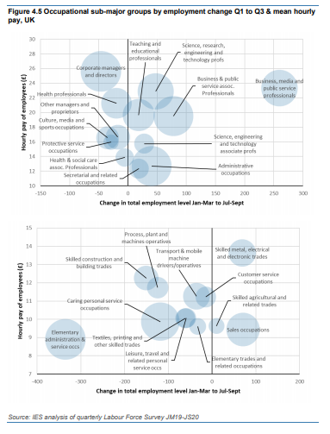
In more detail: occupational growth in a range of areas – how we support these transitions will be key

Slide 25
So… what do we do about all of this?!
Five years ago, in a community centre in Leicester…

Slide 27
https://archive.learningandwork.org.uk/resource/delivering-employment-projects/

Slide 28
I think that ultimately, this comes down to doing four things well
Clear leadership, accountabilities and co-ordination
Working across services to ensure that all of those who are out of work and want to work, or who are in work and want support, get the help that they need
A relentless focus on the individual
Maintaining contact, (re)building confidence, help for the whole person – not about one programme or service; or only about work
We tilt the scales in favour of the most disadvantaged
Built on effective identification and engagement, partnership working, and no ‘one size fits all’
Effective partnership working
With employers, Jobcentre Plus, colleges and training providers, local government, other community organisations

Slide 29
We may be in the foothills of the social and economic crisis
And the next few years may be tough
But this is also the best opportunity that we have had to achieve lasting change in decades
You are so well placed to help deliver this
We need national leadership and commitments to make this stick, but…
Working locally, we can do a lot to help make work better

Slide 30
Getting back to work: Recovering from Covid-19
Tony Wilson, Institute Director, IES
tony.wilson@employment-studies.co.uk
@tonywilsonIES

