Slide 1
BBO evaluation: early findings on results in Covid-19

Slide 2
Brief update on the evaluation
Launched participant survey
Interviews with closing projects
Analysed programme data
Preparing annual report and case study paper
Spring / summer: case study visits to grant holders, participant interviews, more waves of participant survey

Slide 3
Update on programme achievements
As at June 2020…
117,032 participants
49,000 (41%) had one or more indicator of disadvantage (homelessness, offender status, disability, jobless household)
47% were economically inactive
Average time engaged with the programme was 226 days – or around 7.5 months
85,046 people had exited the programme
Over 19,326 moved into employment (22%)
Of those, 38% were economically inactive on engagement
14% moved into education or training

Slide 4
What happened to engagement in the early days of Covid-19?

Slide 5
What happened to results in the early days of Covid-19?

Slide 6
What happened to results in the early days of Covid-19?

Slide 7
What’s the situation looking like now?
Participant survey
Designed to explore destinations and sustainability
Interviews at two points in time: follow up after six months
Target of 400 participants interviewed
First wave of interviews conducted in February, with participants who left in August / September

Slide 8
Where do people go after leaving BBO support?

Slide 9
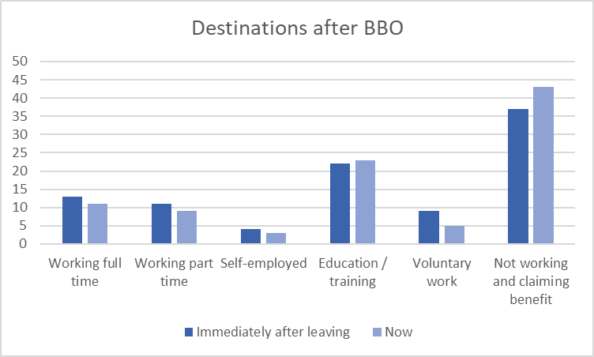
How are those destinations sustained?
55% were still in the same job as when they left BBO
50% of those in work had been taken on permanently
17% were in zero hours contracts
67% worked more than 15 hours per week
39% said that Covid had affected their job, although only 4% had been placed on furlough

Slide 10
How did BBO help?
Outcome | % of all respondents
Improved confidence | 29
Improved wellbeing | 21
Learnt new skills | 14
Improved financial situation | 10
61% of those in work felt they would have struggled to find their jobs without help from BBO
47% of those not working felt the support would help them to find a job in future, due to
improved confidence
improved motivation
better idea of career options

