Slide 1
Motiv8 Building Better Opportunities Greater Manchester
Participant Achievements
Lawrence Milner
Notes:
Overview of Motiv8.
BBO £9.7 million
Greater Manchester
3 years
Aged 25 and over with multiple and complex needs,
disabilities,
substance misuse
DV,
mental health etc.
health
Preventing them moving forward with lives.
Give a brief overview of our model, with a view to PT achievements, progress and outcomes.

Slide 2
A Partnership Approach…
Motiv8 is run by Manchester Athena, a partnership of
housing associations working together to transform people’s lives by improving their skills, employability, health and well-being.
Motiv8 Delivery Partners:
Motiv8 Specialist Partners:
Notes:
Partnership 5 housing partners deliver across GM
7 Specialist partners
Try and market ourselves in terms of moving a participant forward, keen not to be defined as an employability programme, as the softer outcomes PTs achieve are just as important.

Slide 3
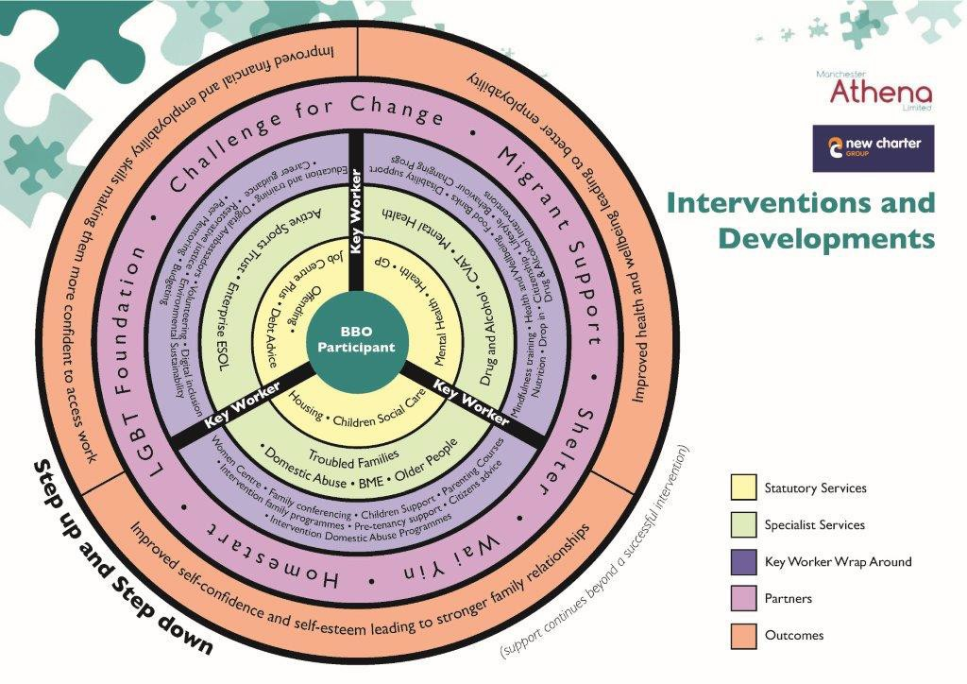
Our Delivery Model
Motiv8 supports people aged over 25 across Greater Manchester who need support to get their lives back on track - whether they are experiencing issues with health, alcohol, drugs, domestic abuse, debt, homelessness or other challenges.
Referral
Eligibility
Action Plan
1-to-1 Support
Specialist Support
Action Plan Review
Moving Forward
Notes:
Take referrals from wide number of stakeholders.
Step up Step down to try and prevent dependancy on individuals.
Utilising existing community assets/ services – in the community.
Attachment Team – job to get the PT on programme.
Undertake initial needs assessment
Create smart action plan – 3 actions tailored to individual need.
KW then co-ordinates provision to implement the AP.
Referring to support agencies.
Dealing with housing issues.
Supporting to attend appointments etc.

Slide 4
Performance to Date
4,328 Referrals received
2,539 Participants on programme
60:40 men to women
25% aged 50+
72% with a disability
15% from an ethnic minority
590 total Results:
432 into education/training
136 into employment/self-employment
22 economically inactive into job search
5,410 Outcomes:
1,871 Health & Wellbeing
2,607 Finance & Employability
932 Self-Confidence & Self- Development
33% of participants exit with a programme result
Notes:
Target 4000 individuals Vs 2539 actual
Attracted more aged 50+ than expected and more with disability.
11% BAME
More individuals classed as unemployed than Eco inactive at entry 70:30 but partly down to our recording. ESA claimaints
45% into a result activity – of those that have exited 33% are exiting with result.

Slide 5
Supporting those Furthest Away from the Labour Market
We have developed referral pathways with as wide a range of agencies as possible, to ensure we are reaching individuals who are most in need of our support.
Notes:
30% of our participants are ex-offenders
72% have a self-reported disability
Development workers
Job Centre video https://youtu.be/2GSqxPEaPG0

Slide 6
Specialist Partner video
Notes:
2 mins
https://www.youtube.com/watch?v=-PmNyeauSwQ

Slide 7
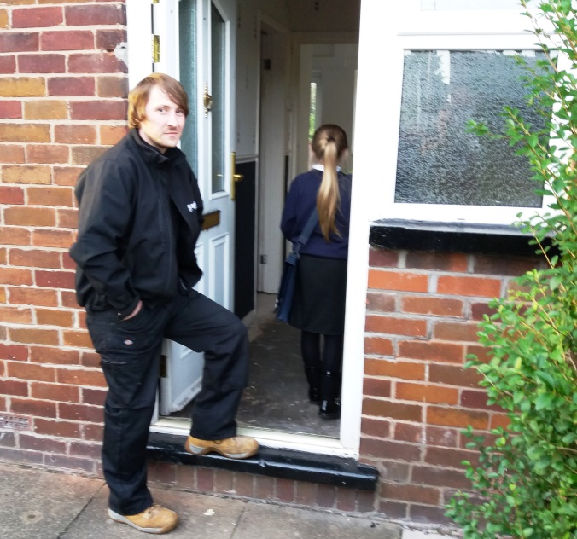
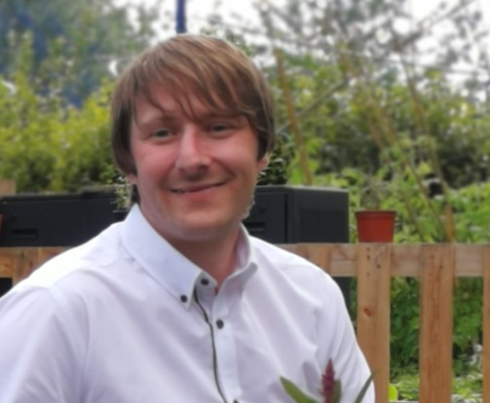
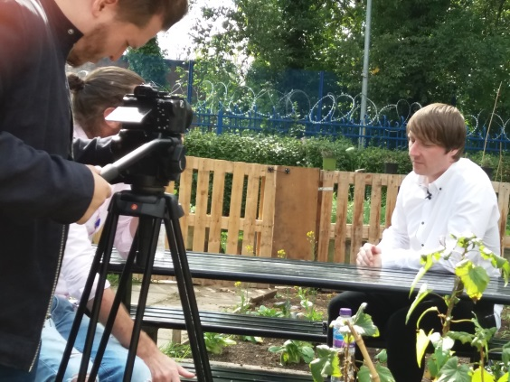
Mark's Story
Before Mark contacted Motiv8 he was living in a hostel. He had signed up for help through Alcoholics Anonymous and also a 14-month rehabilitation programme, who put him in touch with Motiv8.
He was keen to find employment and also improve his housing situation – something that became crucial when he unexpectedly became the full-time parent for his young daughter…
Notes:
Not just about result
http://www.motiv8mcr.org/success-stories
Mark – 4.15
https://youtu.be/ePDq4fYTu-g

Slide 9
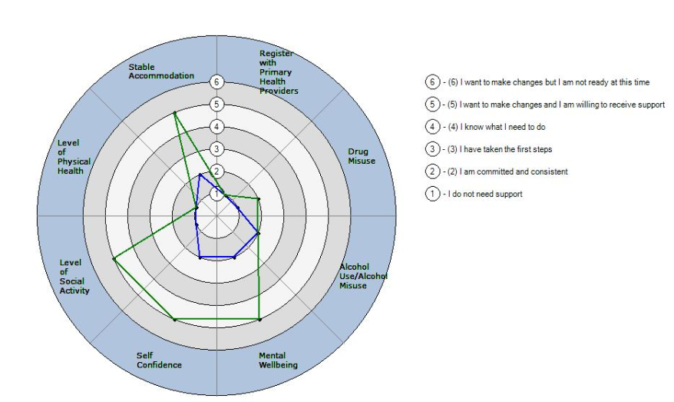
Participant Outcomes
Delivery staff record “soft” Outcomes (progress measures) in the following areas:
Health & Wellbeing
Finance & Employability
Self-Confidence & Self-Development
Mark’s
Health & Wellbeing Assessment
Nov.’17 – Green
Sept.’18 - Blue
Notes:
5410 Unique Outcomes recorded
1871 H&W
2607 F&E
932 SC&SD
Add example radar chart for assessment progress

Slide 10
Health & Wellbeing
“A weight has been lifted from my shoulders, even though there is a long way to go until the house is a home” - Mark
Notes:
Sustained change – activity log demonstrates activities that evidence change.

Slide 11
Finance & Employability
“I’ve found the support around benefit advice invaluable and though there’s still more work to do, I think I’ll be able to get my head round it with a bit more support.” - Mark

Slide 12
Self-Confidence & Self-Development
“The help from Motiv8 and social services has helped me loads to keep looking after my daughter in a more stable environment.” - Mark

Slide 13
Success Stories
Notes:
Not just about results
http://www.motiv8mcr.org/success-stories
(Tracy PT 2) 2mins
https://youtu.be/QLsk2yIlDz8

Slide 14
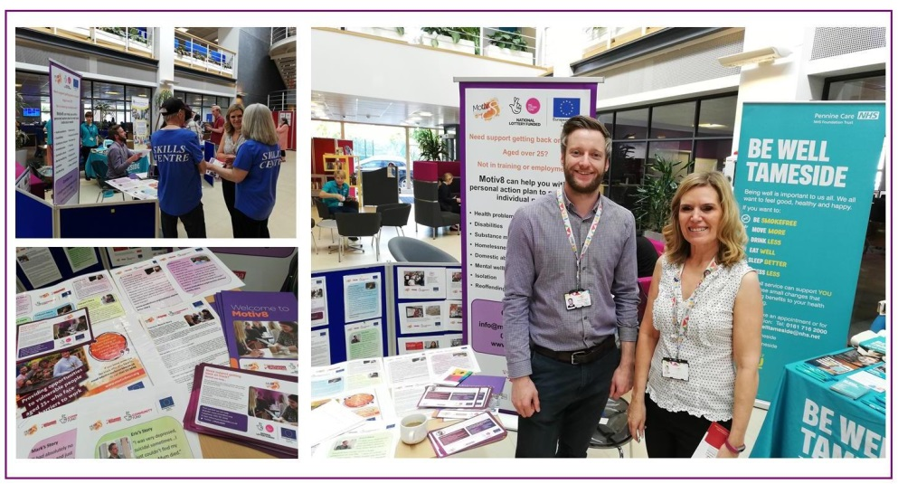
Learning & Overcoming Challenges
Consistency of Delivery Model
Quality vs Targets
Compliance
Participant Attachment
Results
Marketing
Notes:
Consistency of Delivery Model – across multiple partners, lack of matrix management, recruitment, consulting & engaging, programme-wide roles
Quality vs Targets – furthest away, targets are high, doing the right thing for the PT
Compliance – complex requirements, internal audit team, “lost” results
Participant Attachment – timescales & compliance – right people on programme (SPOA), A-Team (stats), setting appropriate expectations (welcome pack),
Results – lag against targets, “results team”, use of delivery model to aid throughput, ensuring quality of journey present, PTs not being exited prematurely, customer satisfaction questionnaire
Marketing – development team, awards, drop-ins & referral pathways, targeting referrals e.g. low on women – DV services/children’s centres; low on BAME PTs – Rochdale hub etc.

Slide 15
Next Steps
Independent Evaluation
Programme Extension – June 2020 and beyond
Specialist Partner Discussions
Notes:
Independent evaluation……
June 2020 undesrpend and Dec 2021 additional 1080 PTs
£4.3 million
Results
Specialist partners discussions refinement of offer.
Value of each partners offer

Slide 16
Motiv8
Any Questions?
Notes:
The theme of the event is participant achievements, so would be great if you could focus on any learning or what has worked for your project in terms of progressing, transitioning and exiting participants and/or anything about measuring the softer/wider outcomes participants may achieve. A little background on the project would be welcome but we’d like to focus on the main themes above. There is 15mins available for the presentation, with a little time for questions.
Project overview
Outputs & results
Case studies (eric/tracy/poss. mark)
SP video
Step-up Step-down
Outcomes (soft) – distance travelled graphs
Learning – process/back office changes to make more efficient (A-Team, results, quality > targets, consistency of model, outcomes recording, targeting referrals, internal audits/SPOA – right people on programme, welcome pack – setting expectations correctly)

