Slide 1
New Horizons
FINANCIAL INCLUSION IN CAMBRIDGESHIRE, PETERBOROUGH AND KINGS LYNN

Slide 2
Who are we and where do we work?
A bit about financial inclusion
What have we learned?

Slide 3
New Horizons
Part of the Building Better Opportunities programme, funded by the European Social Fund and the National Lottery through the Big Lottery Fund

Slide 4
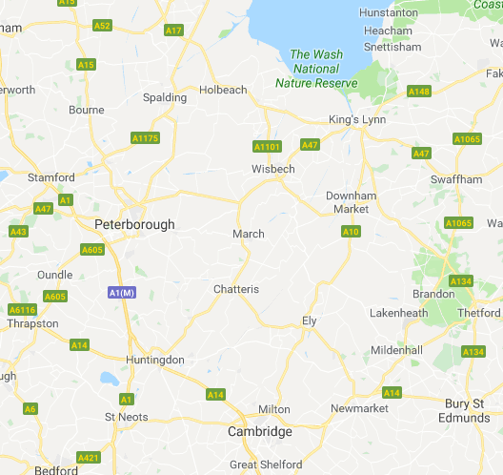

Slide 5
Peterborough
New Horizons
EmployAbility
Community Connections North
Wisbech
New Horizons
EmployAbility
Community Connections North
Community Led ESF funded employability projects
Kings Lynn
New Horizons
EmployAbility
Two other BBO’s from the Suffolk LEP

Slide 7
Why help with money in an employability programme?
Cognitive bandwidth – Mani et al http://science.sciencemag.org/content/341/6149/976
Notes:
Travelling on ryan air and trying to avoid the baggage fee. You think about your basics (food, shelter) not your added extras (getting out into the community, going back to work)

Slide 8
RECOVERY COLLEGE EAST
Don’t compare – treat me as an individual
Help me find safety buffers
Don’t ask ‘what’s wrong’ – ask ‘what helps’
Take at my pace
Trust me when I tell you my priorities
Don’t make assumptions – things change
MONEY ADVICE SERVICE
Fears about being judged
Unlikely to engage on a bad day
Treat me as individual
Want personalised help but not personal questions up front
No one size fits all

Slide 9
People in poverty performed better in tests if they had been asked to recall a proud moment or past achievement
(Hal, Zhao and Shafir, 2014)
Notes:
People performed worse if they were asked to remember their own experiences of poverty in their childhood. How do we work to peoples strengths?

Slide 10
THE RIGHT TEAM
EMPATHY
PRACTICAL
RESILIENT
Build trust quickly and professionally
Able to listen and respond in the moment
Respect for each individual
Look under the surface
Include full range of money support
Find ‘quick wins’- things that make a difference now
Solution focused - tackle the challenges experienced
Acknowledge challenges / know limits
No perfect solutions
High incidence of mental health needs in people supported
Develop own self awareness

Slide 12
Grants of £16,523 awarded
29 moved into volunteering
26 moved into paid work
30 bought a PC, laptop, tablet or phone with internet access
25 started using internet banking
53 set up an email account
£3580 saved on utility bills
66 reduced priority debts, 54 non-priority debts
42 attended a job interview
27 opened a bank, building or credit union account

Slide 14
What have we learned?

Slide 17
Managing the project
Communication is key
A shared MIS is a useful tool
It helps to keep it simple
Independent reps on the board ask helpful questions

Slide 18
About meeting our results and outcomes
We have lost people at crisis resolution point
Into work vs looking for work
Others have become dependant

Slide 19
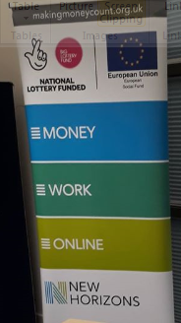
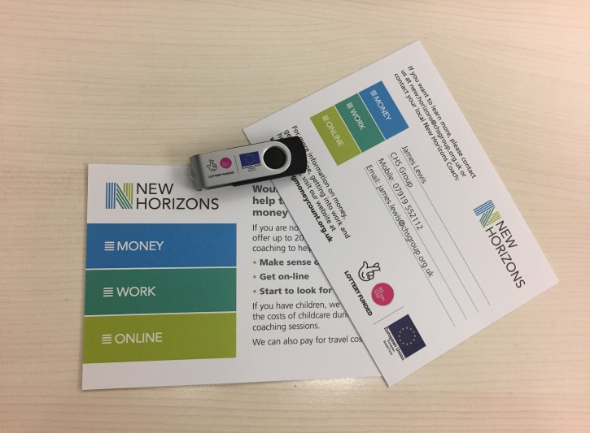
We haven’t needed to spend much on marketing

Slide 20
Sustainable Development

Slide 21
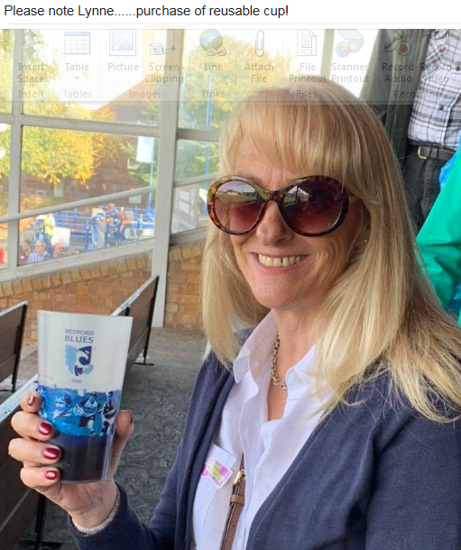
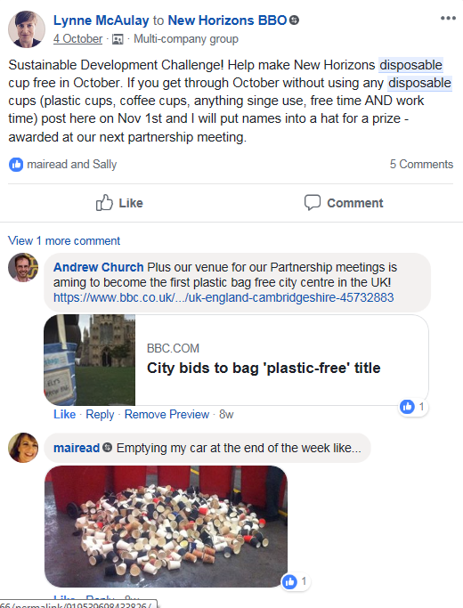

Slide 22
