Slide 1
Building Better Opportunities
Lancashire
Learning Event

Slide 3
Our Projects
August 2016 secured the first two BBO projects:
Age of Opportunity – supporting people age 50 and over
Invest in Youth – supporting people under 25
February 2017 secured a third project:
Changing Futures – supporting disadvantaged groups of all ages

Slide 4
Our Offer
Age of Opportunity – financial capability, digital, volunteering, employability, business start up;
Invest in Youth – employability, basic skills, work experience, confidence, anger management;
Changing Futures – mental wellbeing, financial, basic skills, domestic violence, substance misuse, homelessness, ex veterans.

Slide 5
Our Journey
Invest in Youth
Target | Forecast to Q3 2018 | Actual at Q3 2018 | Performance
Participants Supported | 567 | 506 | 89%
Participants into Jobs | 30 | 56 | 187%
Participants into education | 32 | 34 | 106%

Slide 6
Our Journey
Changing Futures
Target | Forecast to Q3 2018 | Actual at Q3 2018 | Performance
Participants Supported | 735 | 677 | 92%
Participants into Jobs | 50 | 42 | 84%
Participants into Education | 85 | 25 | 29%

Slide 7
Our Journey
Age of Opportunity
Target | Forecast to Q3 2018 | Actual at Q3 2018 | Performance
Participants Supported | 1112 | 615 | 55%
Participants into Jobs | 60 | 62 | 103%
Participants into Education | 65 | 7 | 11%

Slide 8
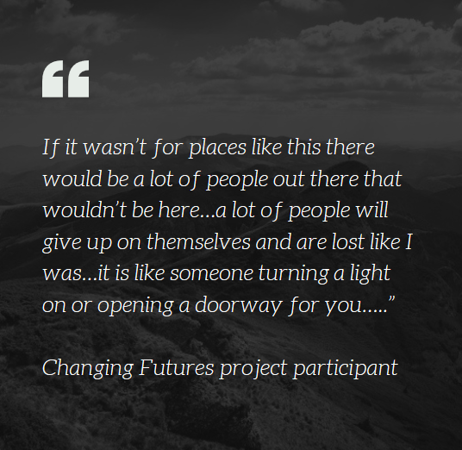
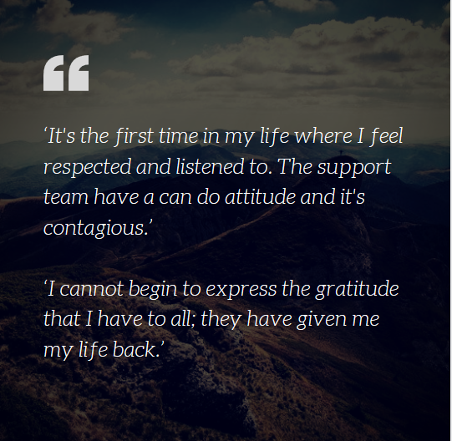
Quotes from Evaluation

Slide 9
Our Evaluation
Invest in Youth
Without the project often people would be continuing to do ‘nothing’, being aimless and ‘lost’.
In some cases impact was even more profound, with several participants stating they may no longer be here if it wasn’t for the support they’ve had.
Keyworker model is proving effective in providing essential ‘hand-holding’ for young people with diverse needs.
Flexible, extended time period allows relationships to develop to maximum effect.
IIY is making a significant difference to the lives of young people who are often very low in self-esteem, had negative experiences of education, no work experience, little direction and motivation, and mental health issues.
96% of participants reported being more satisfied with life now compared to before they signed up for the project.

Slide 10
Our Evaluation
Changing Futures
Participants have received the most wide-ranging support demonstrating the need for holistic support for these most disadvantaged individuals
Partnership has an impressive range of skills, specialist services, and partners that are truly embedded within their communities
When CF participants speak of repeatedly being treated as ‘cattle’, not as an individual, with no respect, it is clear that this project is helping address this – all participants felt respected and cared for
The strong bonds with coaches have been central to this and the ability to be listened to, and supported with, any concerns and issues an individual may be facing, and most importantly, helping them to tackle issues one by one, slowly building confidence, resilience and motivation
The impact on progression and wellbeing was often profound amongst those involved in the consultation, from just reaffirming to someone there are caring people out there, through to inadvertently saving someone’s life.

Slide 11
Our Evaluation
Age of Opportunity
Some very positive outcomes, but also issues with the delivery model which have exacerbated the challenges in finding and engaging with the target population (particularly economically inactive) to meet ambitious targets.
The elements of the support deemed most important and useful have been the motivation/mentoring support and supporting with practical skills such as developing CVs and interview techniques.
Often participants are low in self-esteem and the project has supported individuals to develop soft skills as much as practical knowledge and skills; 89% agreed they are more confident now.
The fact that the project offers tailored support with no particular time-pressure is also seen as a strength.

Slide 12
Our Lessons Learned
All 3 projects:
Gaps in provision: Wellbeing Support and Financial Capabilities support for participants.
Eligibility/sign-up: lack of clarity on eligibility key issues/ volume of documentation too challenging for many partners and is a key threat to partner withdrawal/ continual changes difficult to keep up with.

Slide 13
Our Lessons Learned
Age of Opportunity
Navigator role: mixed views on the effectiveness of the role/ cause of some delays in signing up new participants/ some confusion for participants who felt they were asked to meet too many people.
Partnership working: silo working/ partners lacking understanding of the role of others/ duplication of effort.
Engagement: partners told us that finding eligible participants is the most challenging thing about the project.

Slide 14
The changes we have made…
Incorporate Wellbeing Provision
Increase Financial Inclusion Provision
Filling geographical gaps in delivery
Review the Age of Opportunity delivery model
Marketing refresh to increase engagement of participants
Additional resources to help partners reduce document error rates

Slide 15
Case study film – BBO in action

Slide 16
Thank you – any questions?
donna@selnet-uk.com 01772 200690
www.selnet-uk.com/bbo

