Slide 1
BBO – Removing Barriers/Rebuilding Lives
Project Director – Andrew Marshall
Operations Manager – Tracy James

Slide 2
BBO – Removing Barriers/Rebuilding Lives
Activate Learning has been working with partner organisations to deliver a free programme to help individuals get the skills and confidence to get back into work.
Building Better Opportunities has been focusing on supporting the following:
The unemployed and economically inactive
People ages 50+
Ethnic minorities
People with disabilities
People in rural communities
“Building Better Opportunities has been a great experience for me. It helps people realise that they are worth more than they think they are. I am pleased to be part of this project that is helping make a difference to the lives of learning participants.”

Slide 3
Actual Figures vs Target Figures
Below is a graph that compares our target figures to the actual figures achieved.
100% over achieved

Slide 4
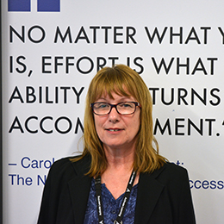
Case Study from Linda Elmer
“I used to be quite discouraged about it all. But my tutor, Kate, and job coach, Jess, were helpful and encouraging. For example, I was shown how to use CV templates. For the first time in years, I had an updated CV. Jess really took the time to get to know me, so she could support me better.”
Linda Elmer, Project Administrator

